Slide 1
How to get a PhD
An illustrated guide
Asterios Katsifodimos - TU Berlin
asterios.katsifodimos@tu-berlin.de
http://www.user.tu-berlin.de/asteriosk/

Slide 2
Disclaimer
The advice in this slide set is generic. However, it was primarily designed for use in the DIMA team (dima.tu-berlin.de). Bear in mind that the structure of the group is somewhat different from other groups:
PhD students find themselves doing the job of a postdoc (helping out in writing proposals, advising master theses, preparing deliverables, teaching, etc.)
Postdocs find themselves doing the job of an assistant professor (full time teaching, writing proposals, running projects, advising students, etc.)
The professor finds himself doing the job of a department head (meetings, designing a curriculum for the university, invited talks, talking to ministers, etc. ).
Take everything with a grain of salt, and think for yourself what’s best for you. There’s an exception to every rule (but exceptions should not become the rule).
As always: I love exaggeration as a means to make my point ☺

Slide 3
How does a typical timeline of a PhD look like?

Slide 4
Year 1
Oct.
Nov.
Dec.
Jan.
Feb.
Mar.
Apr.
May
Jun.
Jul.
Aug.
Sep.
Come up with subject, help senior student/postdoc, do project work, teaching.
Depression
Year 2
Oct.
Nov.
Dec.
Jan.
Feb.
Mar.
Apr.
May
Jun.
Jul.
Aug.
Sep.
Write a paper and submit.
Fix and resubmit
Internship
Reject!
Depression
Year 3
Oct.
Nov.
Dec.
Jan.
Feb.
Mar.
Apr.
May
Jun.
Jul.
Aug.
Sep.
Write internship paper and submit.
Fix and resubmit
Depression
Rethink your life
Reject!
Depression
Year 4
Oct.
Nov.
Dec.
Jan.
Feb.
Mar.
Apr.
May
Jun.
Jul.
Aug.
Sep.
Write a paper and submit.
Thesis writeup
Depression
Find a job

Slide 5

Your advisors (postdoc or prof or researcher or …)
They can (and should)
Review your drafts
Give you feedback
Be your bullshit filter
Put your thoughts in order
Help you focus
Assign tasks to you which you do not like
Find funding for you
They should not (although they could)
Find you a full-fledged PhD subject
Write a paper for you (but they can edit* it)
Find complete solutions to your research problem
Write your code
*editing can be anything from spotting typos to rewriting a paper.

Slide 6

Postdocs writing a paper: so, who will implement this?
From: Research in Progress, Tumblr blog.

Slide 7


Relationship with your postdoc/advisor
Demand their time!
Send them drafts
Knock on their door
Remind unanswered emails
Assign work to them - before somebody else does!
Take their feedback seriously
They have seen more than you have
They have written at least a couple of CORE A* papers themselves
Do not take their feedback too seriously
They are not as deep as you are in your subject
Sometimes they think of the big picture; may distract you
You should be writing a focused research paper, not a vision paper
Sometimes they think of project deliverables
You are responsible for your PhD. There is no messiah to get it done for you.

Slide 8
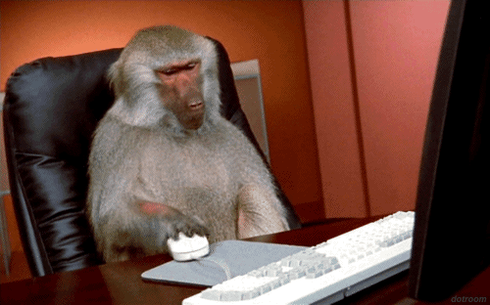
Intership
Find somebody with whom you really want to work
Do not be a code monkey
You have to agree in advance on what you will be working on
You have the right to set the rules; you can reject an internship offer.
If an internship does not contribute to one of the following, stay home
Paper output
Insight from a large company
Serious networking
Later Employability

Slide 9

Project work
Common mistakes
Doing more work than needed
Instead: do the minimum amount of work to keep your partners happy and the project on track.
Having that feeling of satisfaction at the end of the day after project work?
Do you feel that you have done enough (for the project)? Well, think again.
There’s a PhD to finish and a couple of Core A* papers to be written. No project work can get you there!
There’s a very satisfying feeling in doing structured (project) work instead of unstructured, and full of uncertainty, research work. Do not fall in that trap.
If your project work is more than 30% of your time: talk to your advisor!
European Project Meeting

Slide 10

Find yourself a bullshit-filter peer
How to use a bullshit-filter
Think of something new
Talk to your bullshit filter
If bullshit-filter rejects idea
goto 1
Else
Input from postdoc, prof
Implement
Write a paper
A good bullshit filter peer can be as useful as an advisor.
Choose a critical/smart/senior one.

Slide 11

“Your” students
Think again before you assign work to a bachelor/master/internship student
They cannot and should not do your work
Research happens as you go, fixing mistakes and coming up with ideas after runnign experiments. Do not let the master student throw away (or enjoy) those!
Do not put students in any critical path
I did not have any. You can also do without.
They can assist you with
“brainless” coding
Demonstrators
Project deliverables
“PhD advising a master” Research in progress, Tumblr blog.

Slide 12

Have a life (out of the office)!
Extracurricular activities are important.
It’s never “lost time”. It can also be an “investment in rest”
The best ideas come in
The bathroom (in a variety of places)
In front of a beer pitcher
After sleeping and dreaming (seriously!)
Watching a theatrical play
…
More time at the office does not mean more results
Performance = work/time
Time at the office should not be browsing and hanging out in the coffee room!
Get the job done and leave the campus! Now!

Slide 13
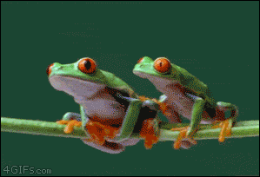
FAQ (try to answer the questions first before you see the answers in the next slide)
I’m still struggling to find THE idea to change the flow of science. Should I keep searching or write a humble paper?
This PhD stud. needs help to write his paper, should I help?
This PhD stud. had great results. I do not think I will be as good. Should I quit?
This PhD stud. is working on that cool project, should I also work on something similar?
100

Slide 14
Answers
I’m still struggling to find THE idea to change the flow of science. Should I keep searching or simply write a paper on a humble idea?
Be pragmatic. In the absence of a breakthrough idea start and finish the damn paper! Nobody became a world class scientist with their first paper.
This PhD stud. needs help to write his paper, should I help?
If you are in your first 6 months and you can learn from the student, yes! If you are in your second year and instead of writing your own papers you are the code monkey of another Phd stud., you are doing something wrong.
This PhD stud. had great results. I do not think I will be as good. Should I quit?
No you should not. You will be amazed by how many people have thought of this and in the end have finished a very high-quality PhD. Work hard, be positive, aim high, follow the advice above. You’ll get it done!
This PhD stud. is working on that cool project, should I also work on something similar?
No! Find your own project and do not follow the peer PhD student unless there’s a clear differentiation and reason for you to publish your own paper.

